Slide 1

Student (Senior) Category – Universities
Human Health & Potential (HHP)
By HIGY

Slide 2
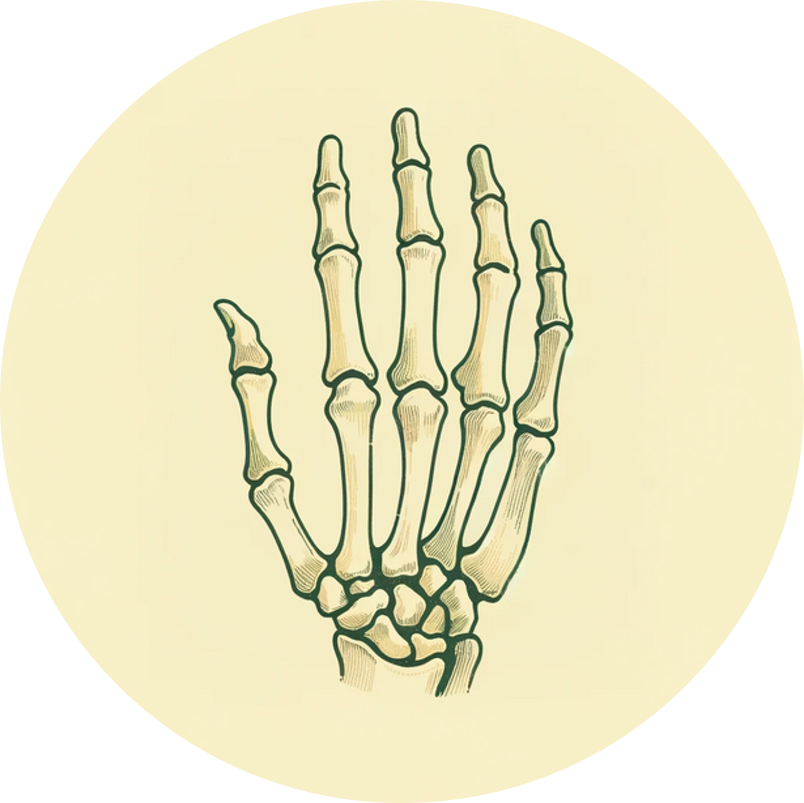
PROBLEMS
What is bone age?
Bone age: data for assessing children's skeletal
Development, used clinically for growth assessment and diagnosis
By doing bone age evaluation, some hidden disease can be detected. If we fail to detect them, it may lead to deformity.

Slide 3
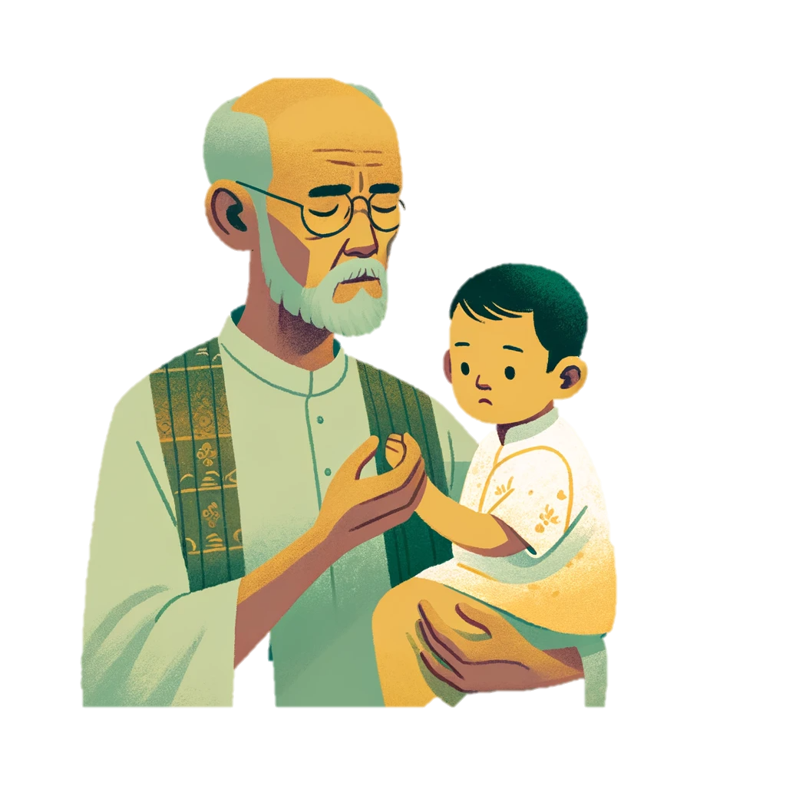
PROBLEMS
But, WHAT STOP parents from doing bone-age and other children’s deformity tests?

Slide 4

PROBLEMS
High Costs
Medical Resource Inequality
Human Bias Exists
Those kind of check is very expensive in big hospitals
Also, very difficult to get a reservation
Community hospitals are unable to offer those kind of service
Lack of professional physicians
Even experienced paediatricians can make mistake in diagnostic process

Slide 5

PROBLEMS
There exist some kind of machine for these problems, but...
Low Speed
Expensive
Machine Bias
Do not based on deep learning
Inadequate training data
Such devices contain function modules for x-ray imaging，which is unnassary and increase the cost greatly
Different type of machine can give quite different results, cause confuse

Slide 6
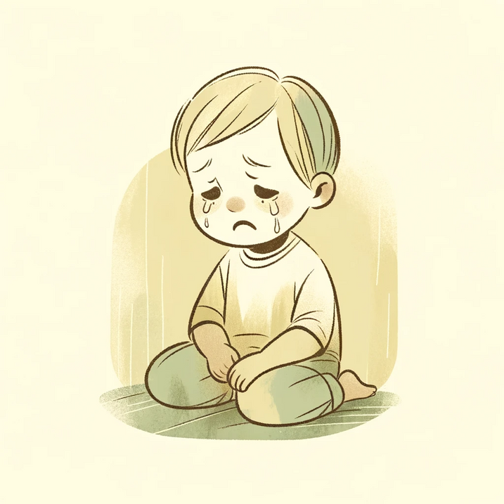
PROBLEMS
Due to these deformity that could have been detected and treated...
Doing Bad In Playing Sports
Abnormal Appearence
Confronting Discrimination
Their wellbeing and further development will be greatly harmed!

Slide 7
SOLUTION & OPPOTUNITY
Construct a platform armed with neutral networks (AI tools) to conduct tests detecting kid’s hidden deformity
OUR SOLUTION IS:

Slide 8
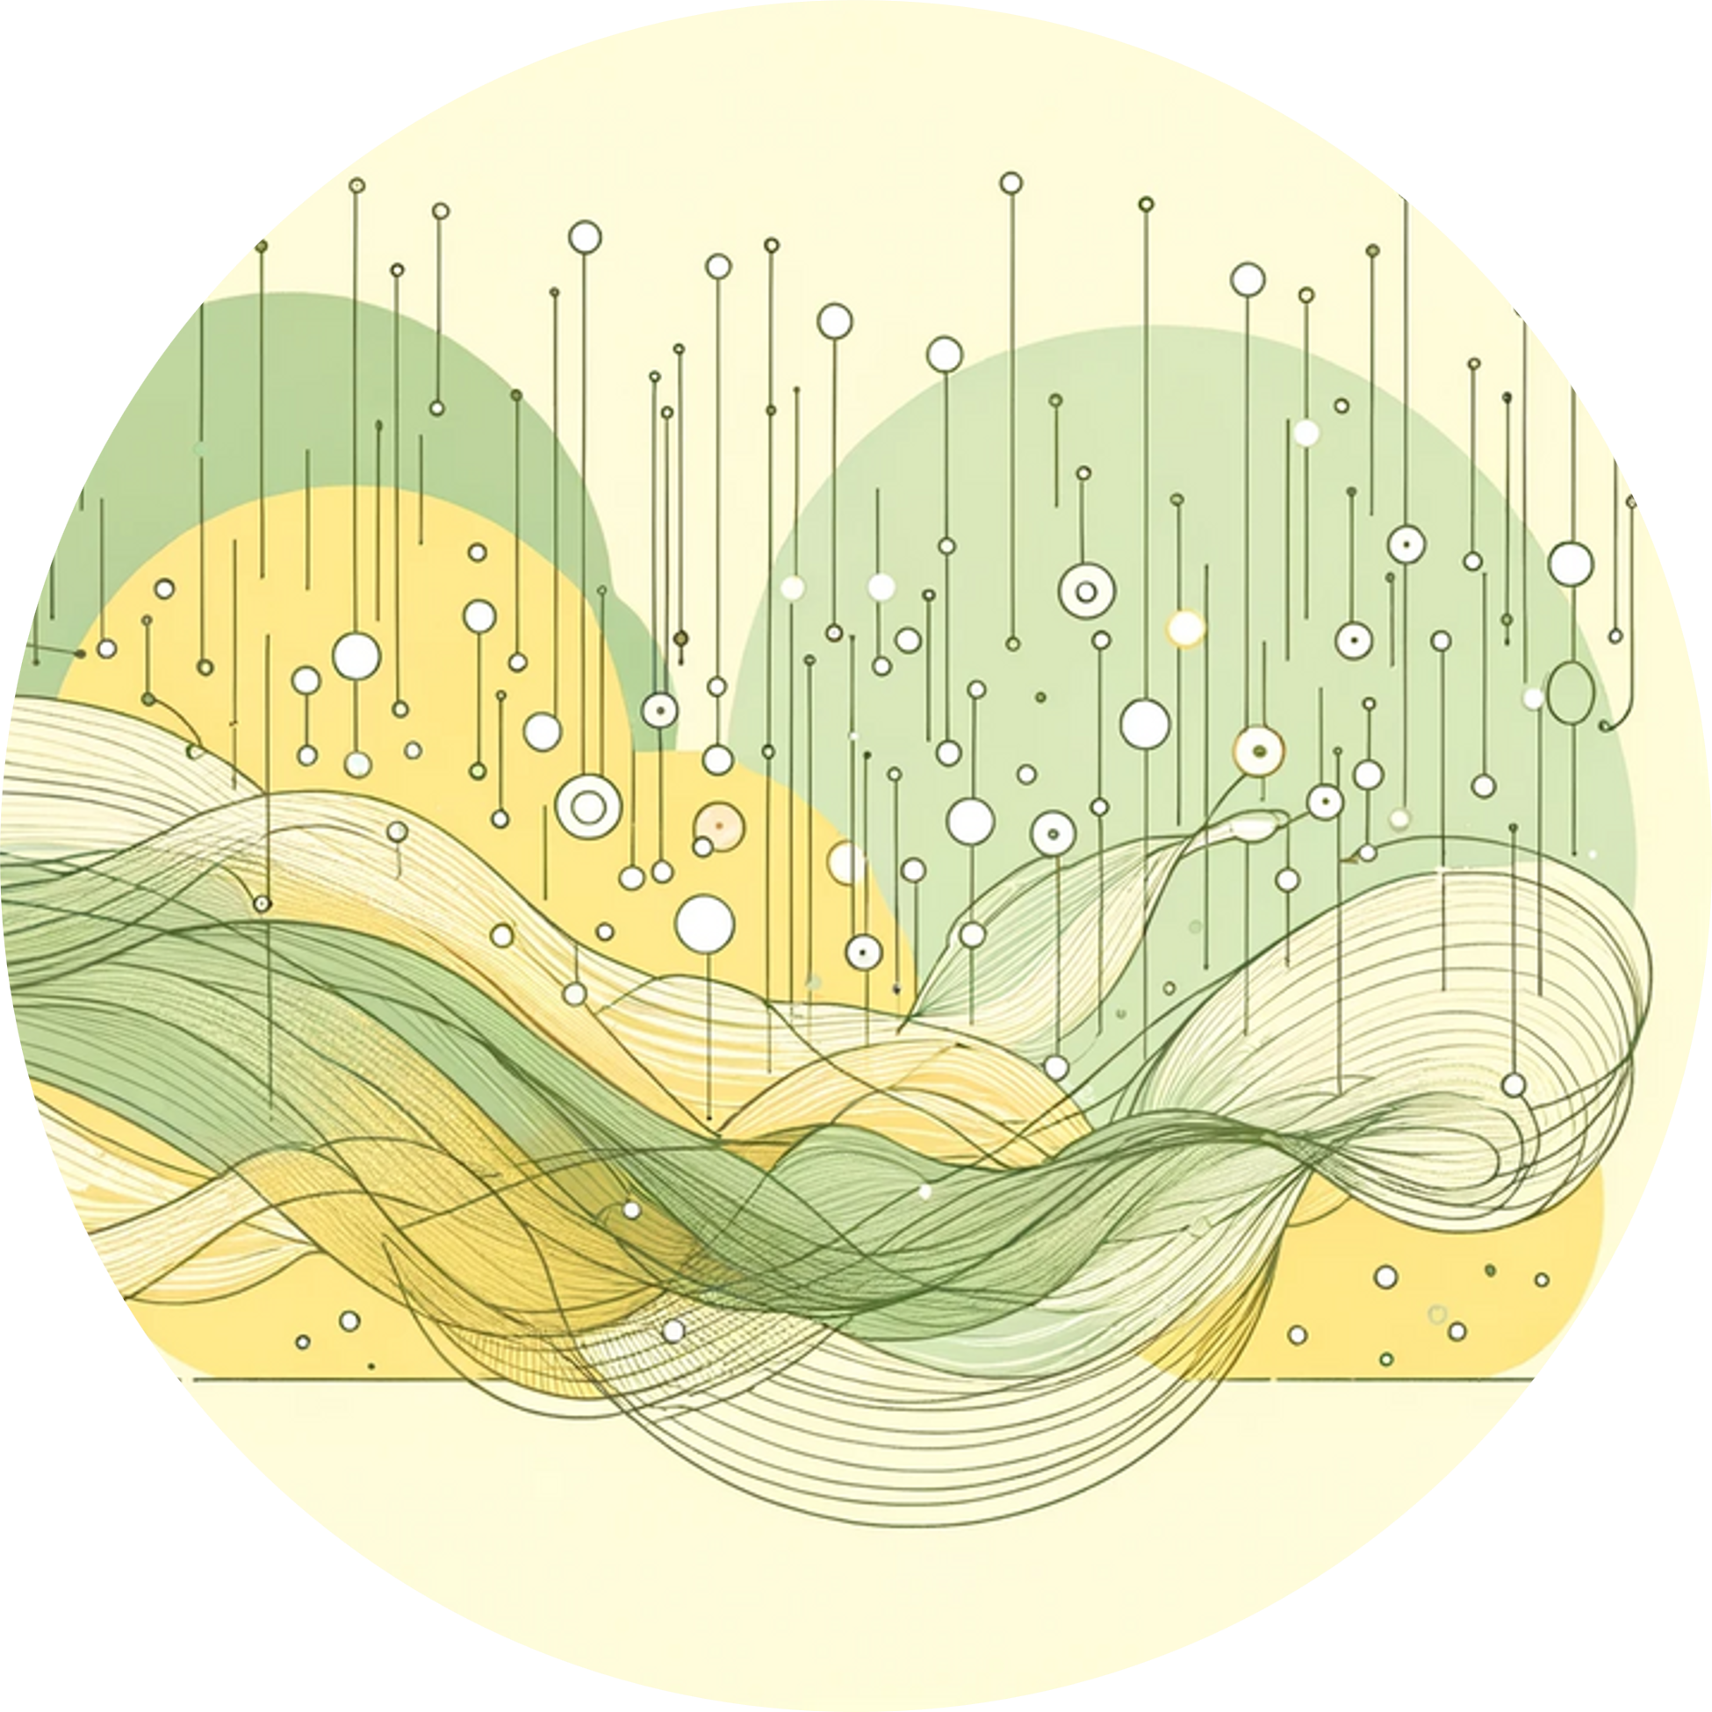
UNDERLYING TECHNOLOGY
With the help of AI tools...
Unique Value For Customer
Easy access (can log in at home)
Innovation Point
Very cheap (no human work, no x-ray device)
Fast speed (no longer need a reservation)
Filling up in a gap in the field of children growth that few have discover before
Detect points in conquer machine bias occuring in existing products considering deformity maesuring
The business method combined with our product is quite creative and disruptive with the idea of de-ceterlization

Slide 9

SOLUTION
The most important point, with the help of HPC....
WE CAN CONQUER THE BIAS !
Fully Exploit The Existing Abundant Data
Previous products failed to fully exploit it, so their machines have quite obvious bias.With the help of hpc, we believe our model can be fully trained and will perform much better.
Make Tailed Models For Different Region
Due to lack of classification, some training data from different region are mixed together in previous products.
With the help of HPC, we can make different options of models for different regions’s children, which can make the test result much more precise than existing ones.

Slide 10
WHAT MAKES OUR PRODUCTS STAND OUT?
COMMUNITY HOSTPITAL
Parents merely take x-ray here, and the cost is relativly tiny
PARENTS WITH OUR PRODUCT
Parents upload the x-ray imagine to our systems, and it will evaluate the result and offer advice
BIG HOSPITAL
According to the advice given by the system, parents can consult with a professional physician for further evaluation and treatment
We come up with a unique business method...

Slide 11
GO-TO-MARKET STRATEGY
PROSPECTIVE BUYER
WHO WILL BENEFIT FROM THIS?
Parents paying attention to their kid's health
Doctors willing to imporve their productivit
Community hospital willing to expand their service
SIZE OF THE TARGET MARKET?
Children's wellbeing can be secured
Hospitals can expand their service and gain more income
Parents can easily get access to high quality service with low cost
Tens of millions of kids
(merely in china)

Slide 12
GO-TO-MARKET STRATEGY
SOM
Most cities in east Asia
SAM
Almost every city in the second world
TOM
The entire first and second world

Slide 13
PRODUCT ROADMAP
Feb. 2024
BUD-Bone-Age v1.0
Bone-age evaluting AI
Apr. 2024
June 2024
Recommendation for the nearest hospital
Evaluate bone age(primary stage)
1k customer try the trial
AVG NPS>5
BUD-Bone-Age v2.0
Tailored model
Tailored model of bone-age measuring for different regions
10k customer try the trial
AVG NPS>5
BUD-Smart-Recommendation
The system will give recommendation of the nearest hospital to conduct follow by treatment toward hidden disease
50k customer try the trial
AVG NPS>7

Slide 14

Thus, parents can keep constantly track of their children's growth condition through our powerful evaluation system !
Eliminate potential deformities and diseases at the source!
Mostly important...
CONVENIENTLY AND COST-EFFECTIVELY!

Slide 15
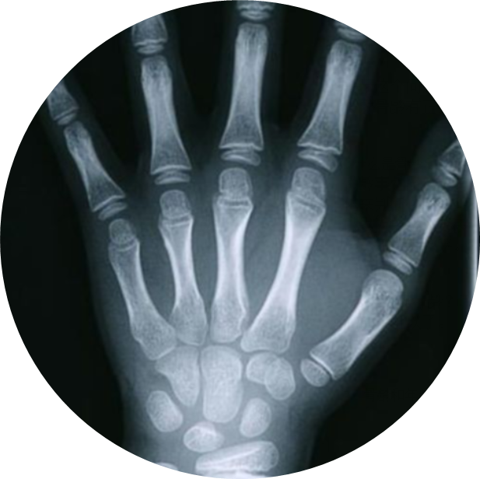
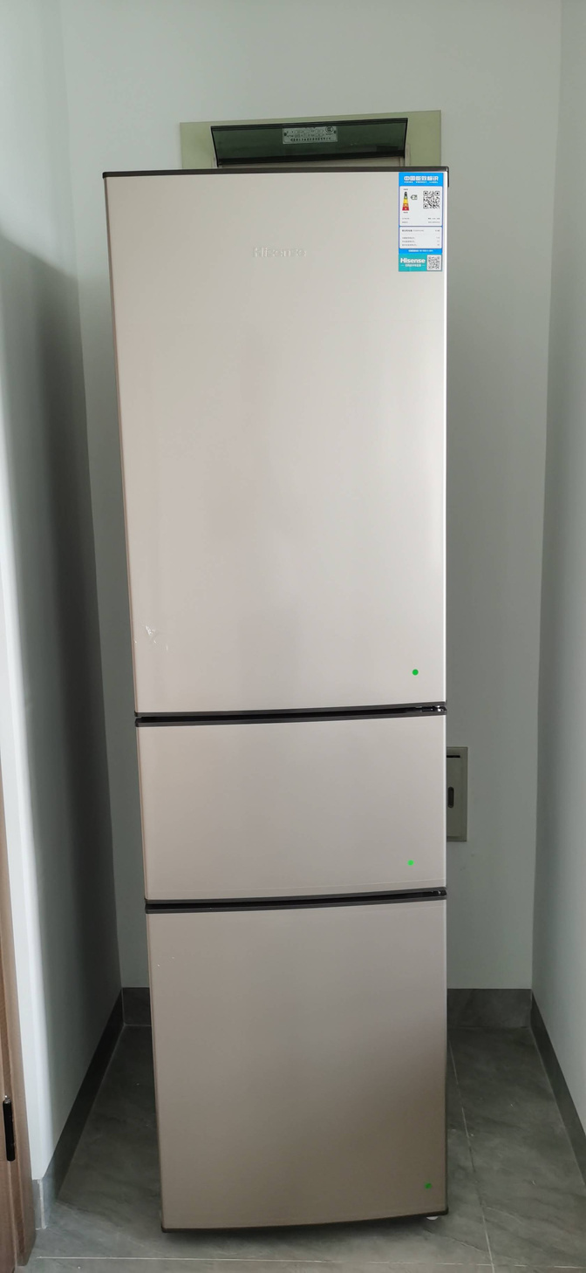
TEAM INTRODUCTION
Leader
Co-leader
Zhang Yichi (Catilony)
Data Science and AI
NTU YR1
Wang Bingxiang (Moon)
Electronic Information Engineering
Changzhou University YR1

